Slide 1


CGB1201 – JAVA PROGRAMMING
Department of Artificial Intelligence and Data Science
Academic Year: 2024 – 2025 (Odd Semester)
Register Number :2303811724322106
Name :SOFIYA.C
Year :II
Semester :III
Section :B
Date :03.12.2024

Slide 2
E - Commerce Platform

Slide 3
PROBLEM IDENTIFICATION
1.User Experience Issues: Slow load times, complicated checkout processes, and lack of mobile optimization can lead to customer frustration and cart abandonment.
2.Technical Problems: Frequent platform downtime, security vulnerabilities, and payment gateway failures can disrupt sales and damage customer trust.
3.Complex checkout process: Issues with integrating inventory, shipping systems, and handling scalability during traffic spikes can impact operational efficiency.

Slide 4
OBJECTIVE
Enhance User Experience: Provide a seamless, intuitive, and fast shopping experience for customers, including easy navigation, mobile optimization, and a simplified checkout process.
Ensure Platform Reliability and Security: Maintain consistent uptime, secure transactions, and protect customer data to build trust and minimize operational disruptions.
Improve Operational Efficiency: Integrate key systems (inventory, payments, shipping) seamlessly and ensure scalability to handle increasing traffic and sales volume.

Slide 5
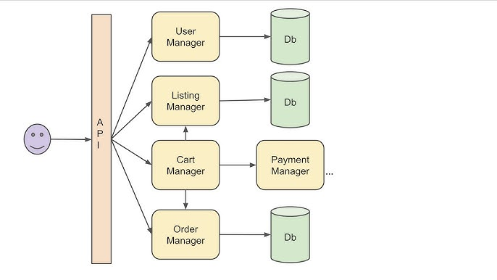
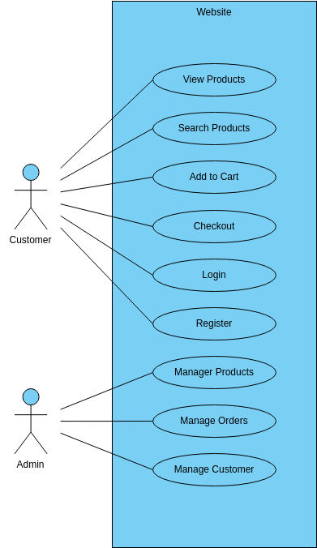
PROPOSED ARCHITECTURE

Slide 6
JAVA PROGRAMMING - CONCEPTS USED
1) OOP
2) File Handling
3) Collections
4) Exception Handling
5) Basic UI

Slide 7
LIST OF MODULES
Product Management Module:
Add/Update Products
Manage Categories
Inventory Tracking
User Account & Authentication Module:
User Registration & Login
Profile Management
Role-based Access
Shopping Cart & Checkout Module:
Cart Management
Payment Gateway Integration
Order Summary & Confirmation

Slide 8
LIST OF MODULES
Admin Dashboard Module:
Manage Products & Orders
Analytics & Reporting
User Access & Settings

Slide 9
MODULE DESCRIPTION
Product Management Module
Allows administrators to add, update, and categorize products.
Manages product stock levels and pricing.
User Account & Authentication Module
Handles user registration, login, and profile management.
Ensures secure, role-based access for customers and admins.

Slide 10
MODULE DESCRIPTION
Shopping Cart & Checkout Module
Enables users to add items to their cart and proceed to checkout.
Integrates payment gateways for secure transactions.

Slide 11
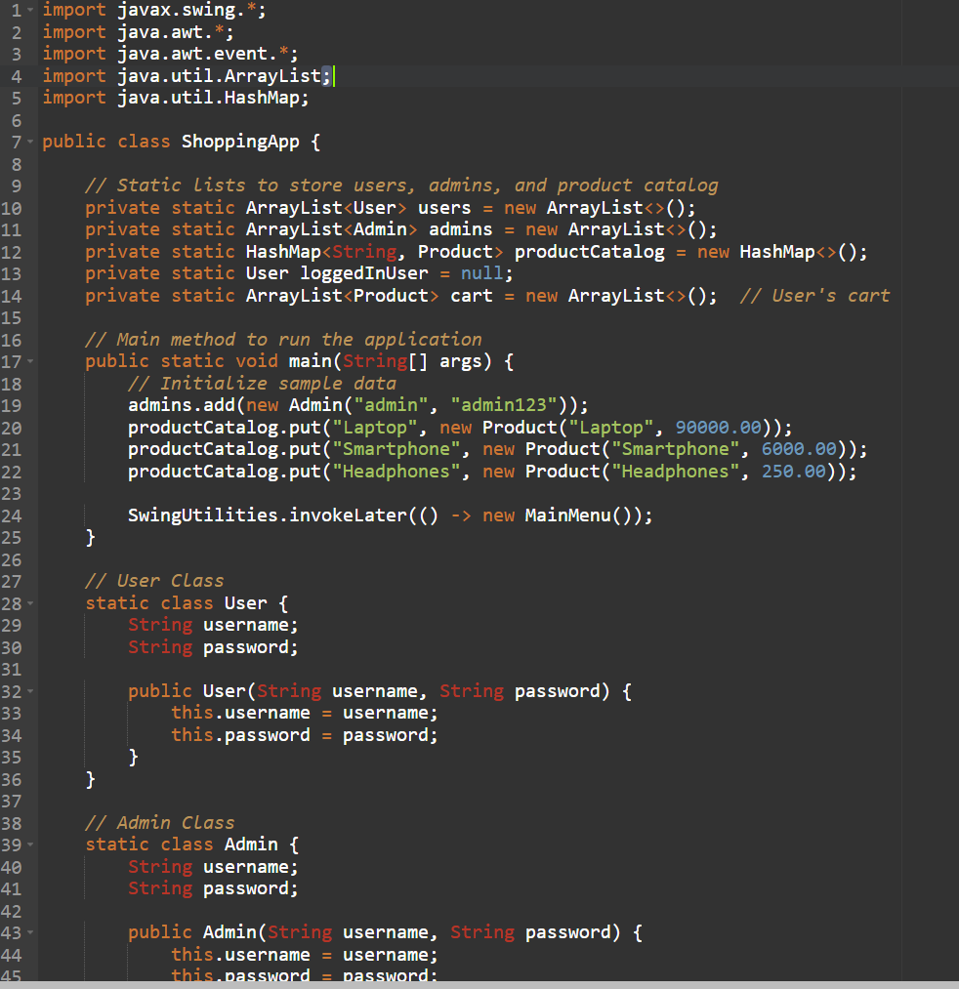
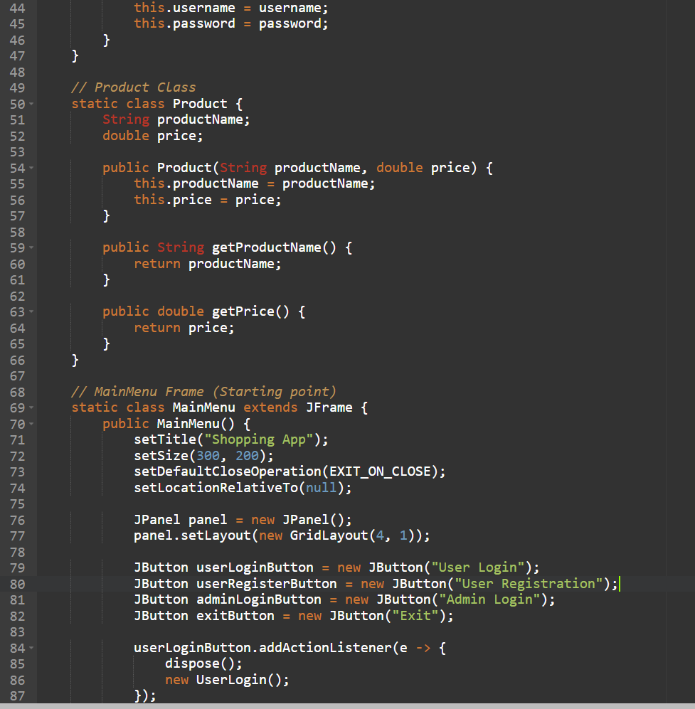
SOURCE CODE

Slide 12
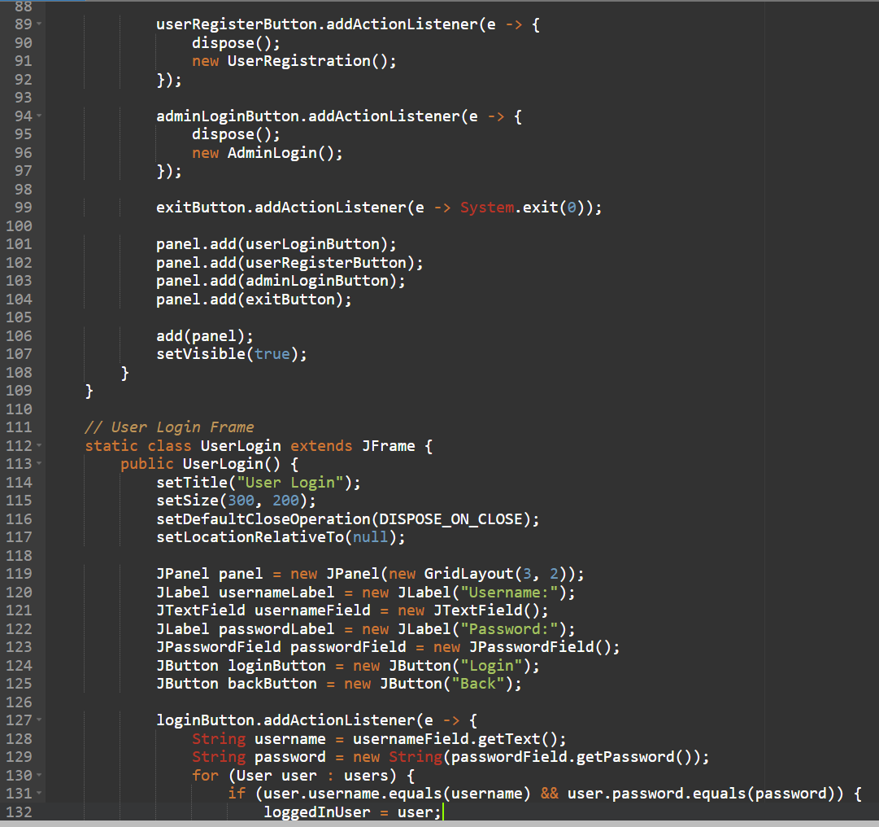
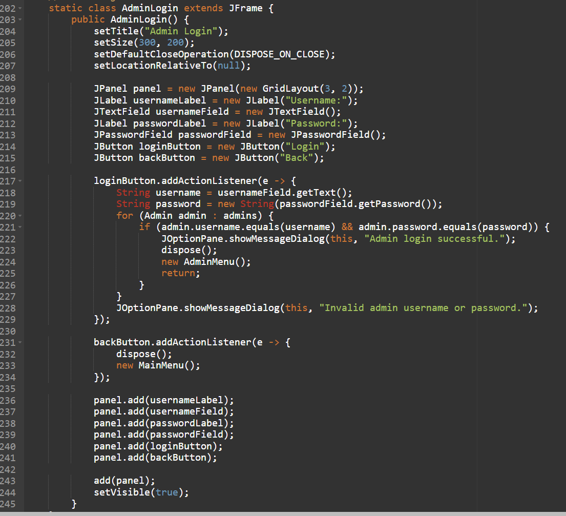
SOURCE CODE

Slide 13
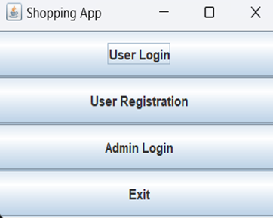
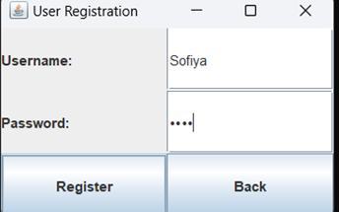
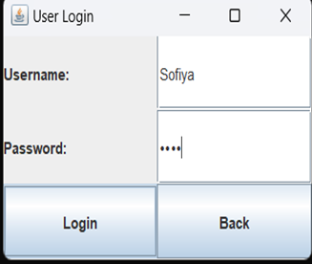
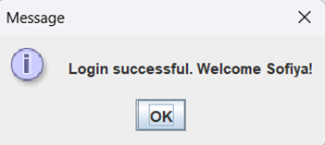
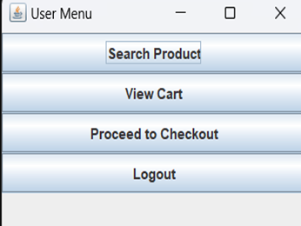
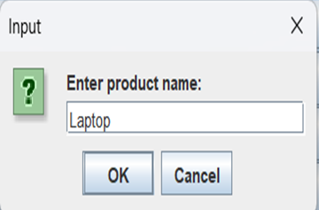
RESULTS AND DISCUSSION

Slide 14
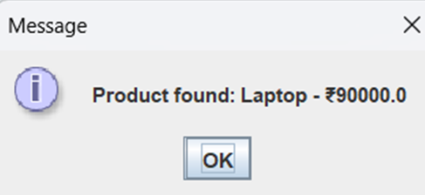
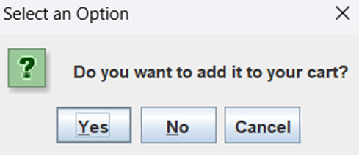
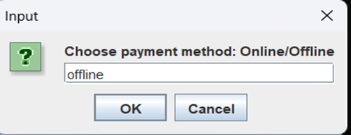
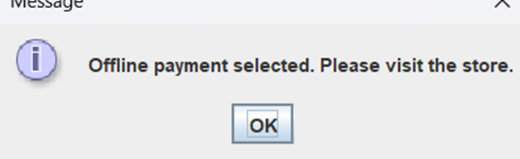
RESULTS AND DISCUSSION

Slide 15
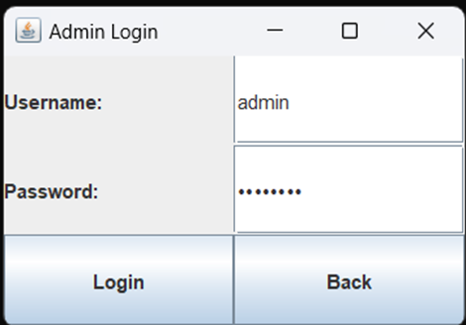
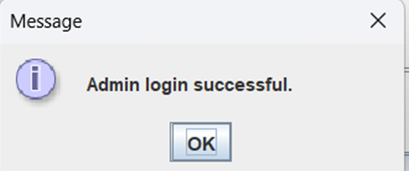
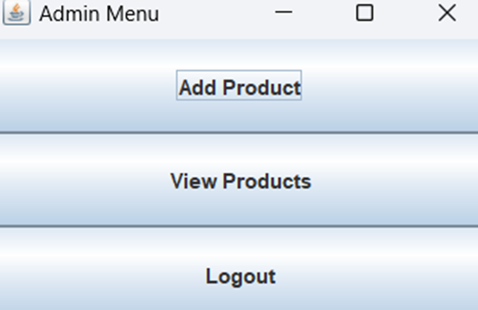
RESULTS AND DISCUSSION

Slide 16
CONCLUSION
Shows how Java can build a simple e-commerce system.
Ready for enhancements like online payments or better UI.

Slide 17
THANK YOU

